Slide 1
Supervised Machine Learning –Bike Sharing Demand Prediction
By- Kashfur Rahman Khan

Slide 2
Content
1)Problem Statement
2)Overview of Data
3)Exploratory Data Analysis
4)Model Preparation
5)Building Model
6)Evaluating Model
7)Getting Result
8)Conclusion

Slide 3
Problem Statement
The availability and accessibility of rental bikes in urban cities is important for enhancing mobility comfort, and it is necessary to provide a stable supply of rental bikes to the public at the right time to reduce waiting time. The key challenge is to predict the number of rental bikes required at each hour to ensure a stable supply of bikes.

Slide 4
Data Description
1)Date = it contains date time
2)Rented Bike count =number of bikes rented
2)Hour = Hour of the day
3)Temperature=Temperature measure
4)Humidity =humidity measure
5)Windspeed =speed of wind
6)Visibility = visiblity of weather
7)Dew point temperature = dew present in environment over the time
8)Solar radiation = radiation coming from sun
9)Rainfall = rainfall measure
10)Snowfall = snowfall measure
11)Seasons = season at that time
12)Holiday = if it is holiday or not
13)Functional Day = if it is functional or non functional time

Slide 5
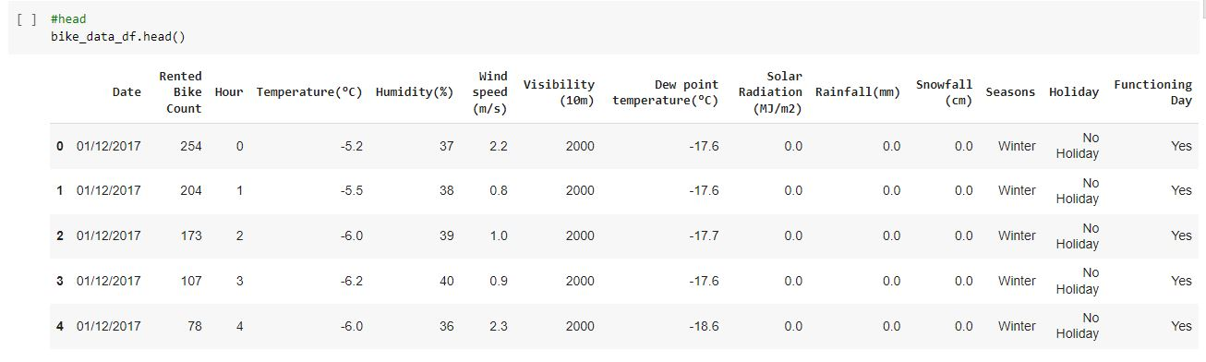

Slide 6
Exploratory Data Analysis
changing date format to date-time format- bike_data_df['Date'] = pd.to_datetime(bike_data_df['Date'])
checking for null values- bike_data_df.isnull().sum()
TYPES OF SEASONS IN DATA- bike_data_df['Seasons'].unique()

Slide 7
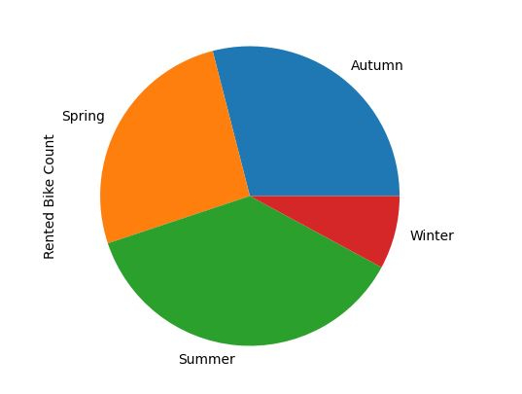
pie chart for bike rented in different seasons
bike_new_df['Rented Bike Count'].plot(kind='pie', subplots=True, figsize=(5, 5))

Slide 8
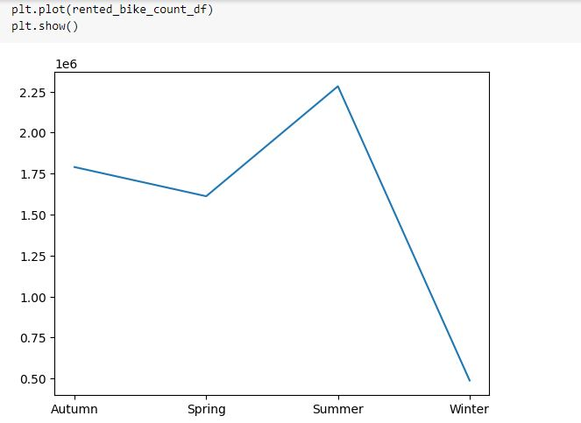
rented bike counts in each seasaon
rented_bike_count_df = bike_new_df.groupby('Seasons').sum()['Rented Bike Count']

Slide 9
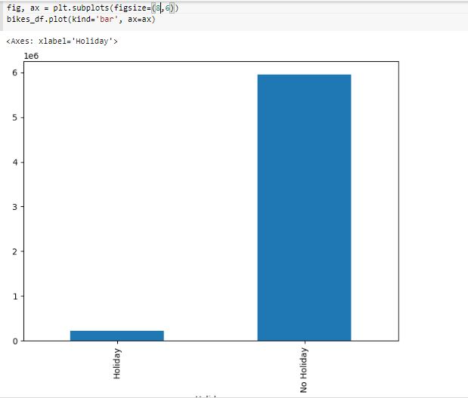
bikes rented each holiday or not holiday
bikes_df=bike_data_df.groupby('Holiday').sum()['Rented Bike Count']

Slide 10
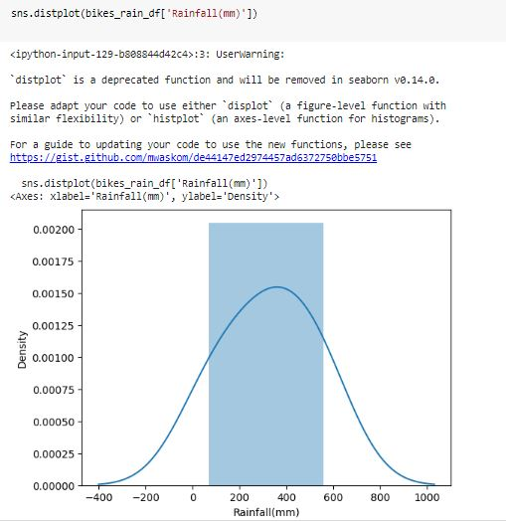
bikes rented in differant rainfall
bikes_rain_df =pd.DataFrame(bike_new_df.groupby('Rainfall(mm)')['Rented Bike Count'].sum())

Slide 11
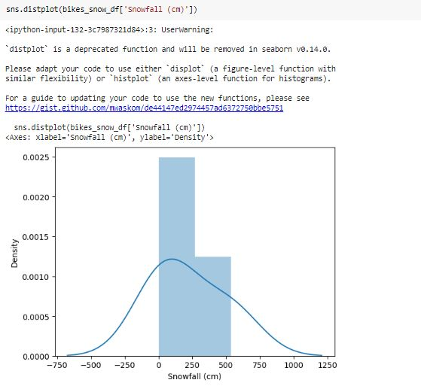
bikes rented in differant snowfall
bikes_snow_df =pd.DataFrame(bike_new_df.groupby('Snowfall (cm)')['Rented Bike Count'].sum())
bikes_snow_df.reset_index(inplace=True)

Slide 12
scatter plot of bike count based on dates -
plt.figure(figsize=(10,6))
plt.scatter(bike_data_df['Date'], bike_data_df['Rented Bike Count'], alpha=0.5)
plt.title(' bike count with dates')
plt.xlabel('date')
plt.ylabel('bike count')
plt.show()

Slide 13
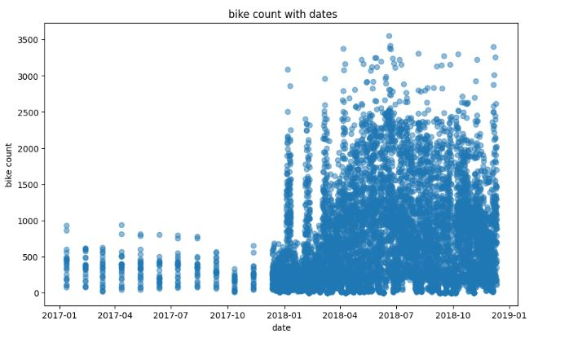

Slide 14
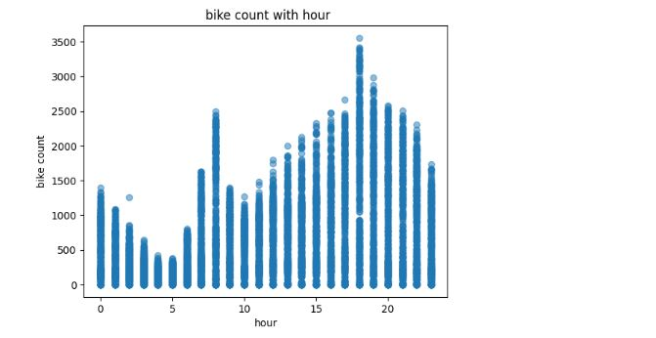
scatter plot of bike count most or least at what hour
plt.scatter(bike_data_df['Hour'], bike_data_df['Rented Bike Count'], alpha=0.5)
plt.title(' bike count with hour')
plt.xlabel('hour')
plt.ylabel('bike count')
plt.show()

Slide 15
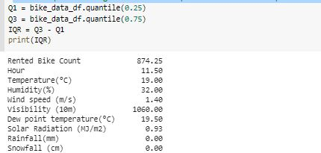
The interquartile range measure to helps us understand how spread out a set of data is.

Slide 16
removing outliers
bike_data_df[list_features] = bike_data_df[list_features][~((bike_data_df[list_features] < (Q1 - 1.5 * IQR)) |(bike_data_df[list_features] > (Q3 + 1.5 * IQR))).any(axis=1)]

Slide 17
filling null values with mean
bike_data_df['Temperature(°C)'] = bike_data_df['Temperature(°C)'].fillna(bike_data_df['Temperature(°C)'].mean())
bike_data_df['Humidity(%)'] = bike_data_df['Humidity(%)'].fillna(bike_data_df['Humidity(%)'].mean())
bike_data_df['Wind speed (m/s)'] = bike_data_df['Wind speed (m/s)'].fillna(bike_data_df['Wind speed (m/s)'].mean())
bike_data_df['Visibility (10m)'] = bike_data_df['Visibility (10m)'].fillna(bike_data_df['Visibility (10m)'].mean())
bike_data_df['Dew point temperature(°C)'] = bike_data_df['Dew point temperature(°C)'].fillna(bike_data_df['Dew point temperature(°C)'].mean())
bike_data_df['Solar Radiation (MJ/m2)'] = bike_data_df['Solar Radiation (MJ/m2)'].fillna(bike_data_df['Solar Radiation (MJ/m2)'].mean())
bike_data_df['Rainfall(mm)'] = bike_data_df['Rainfall(mm)'].fillna(bike_data_df['Rainfall(mm)'].mean())
bike_data_df['Snowfall (cm)'] = bike_data_df['Snowfall (cm)'].fillna(bike_data_df['Snowfall (cm)'].mean())

Slide 18
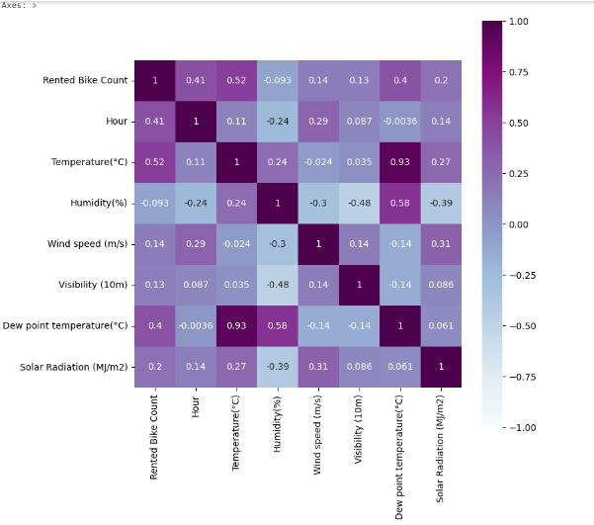
correlation heatmap
plt.figure(figsize=(8,8))
sns.heatmap(bike_data_df.corr('pearson'),vmin=-1, vmax=1,cmap='BuPu',annot=True, square=True)

Slide 19
Calculate Multicollinearity
from statsmodels.stats.outliers_influence import variance_inflation_factor
def calc_vif(X):
# Calculating VIF
vif = pd.DataFrame()
vif["variables"] = X.columns
vif["VIF"] = [variance_inflation_factor(X.values, i) for i in range(X.shape[1])]
return(vif)

Slide 20
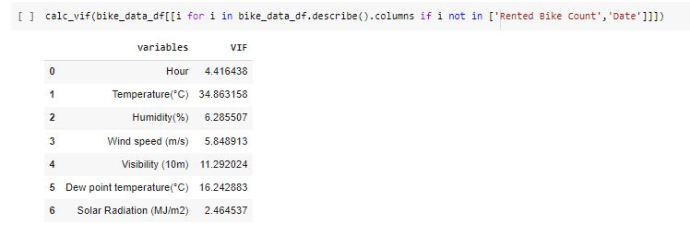

Slide 21
correlation between dependent and independent variable
numeric_features = bike_data_df.columns
for col in numeric_features[1:]:
fig = plt.figure(figsize=(2, 2))
ax = fig.gca()
feature = bike_data_df[col]
label = bike_data_df['Rented Bike Count']
correlation = feature.corr(label)
plt.scatter(x=feature, y=label)
plt.xlabel(col)
plt.ylabel('Rented Bike Count')
ax.set_title('Rented Bike Count vs ' + col + '- correlation: ' + str(correlation))
z = np.polyfit( bike_data_df[col], bike_data_df['Rented Bike Count'], 1)
y_hat = np.poly1d(z)( bike_data_df[col])
plt.plot( bike_data_df[col], y_hat, "r--", lw=1)
plt.show()

Slide 22
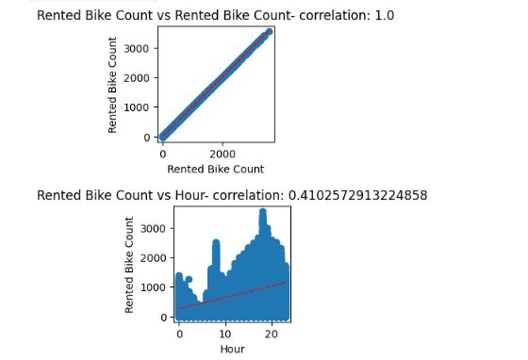

Slide 23
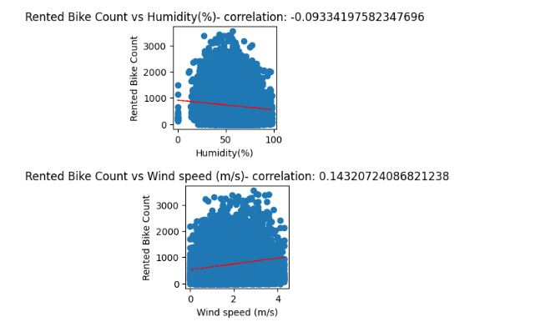

Slide 24
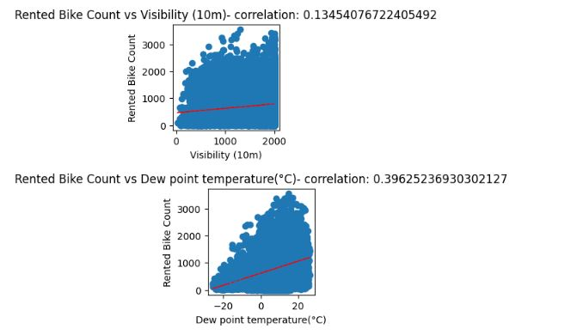

Slide 25
Modeling Data
Creating independent variables=
Y = bike_data_df['Rented Bike Count']
Creating dependent variable=
X = bike_data_df.drop(columns=['Rented Bike Count','Seasons','Holiday','Functioning Day','Date'],axis=1).values
Splitting the dataset into the Training set and Test set=
X_train, X_test, Y_train, Y_test = train_test_split(X, Y, test_size = 0.2, random_state = 0)

Slide 26
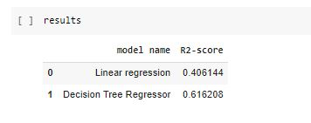
Model used
Linear Regression
Decision Tree Regression Model
Evaluation of Models-

Slide 27
CONCLUSION
* Decision Tree Regression is better than linear Regression in this model
* We are able to extract information and come to necessary information using Exploratory data analysis

